Slide 1

Xamarin
Kishore Chowdary
C-Sharp Corner MVP
Developer Evangelist
CodeSizzler
@kishore_1702

Slide 2
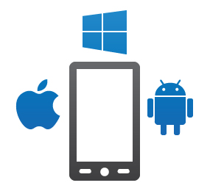
Cross platform Development

Slide 3

Xamarin Development Methods
Xamarin Android
Xamarin Forms
Xamarin Native

Slide 4
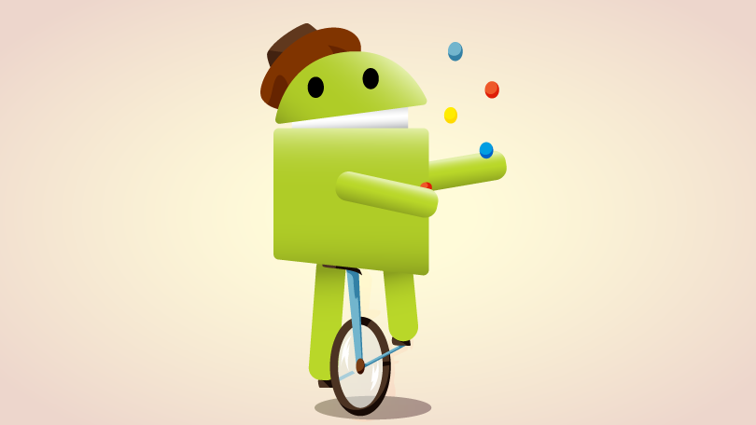
Xamarin Android

Slide 5
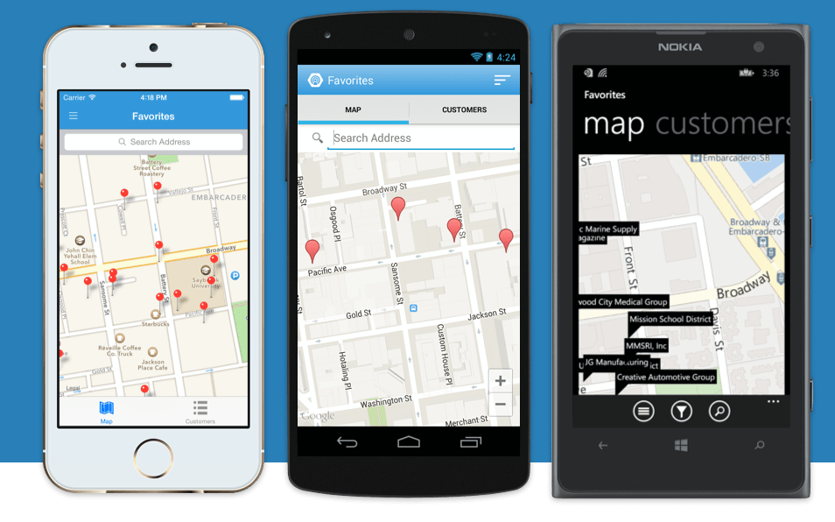
Xamarin Forms

Slide 6
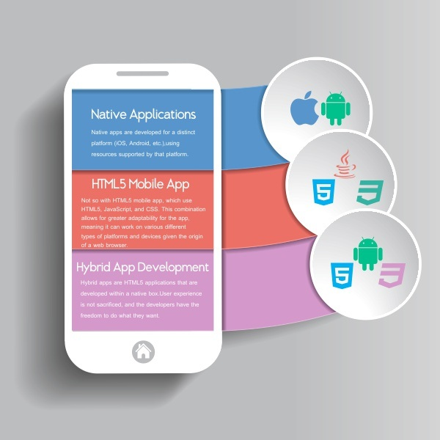
Xamarin Native

Slide 7
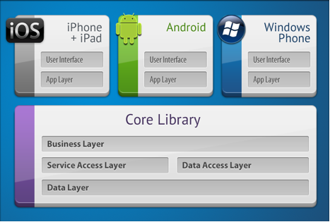
Code Sharing Strategies
PCL – Portable Class Libraries
Shared Project

Slide 8
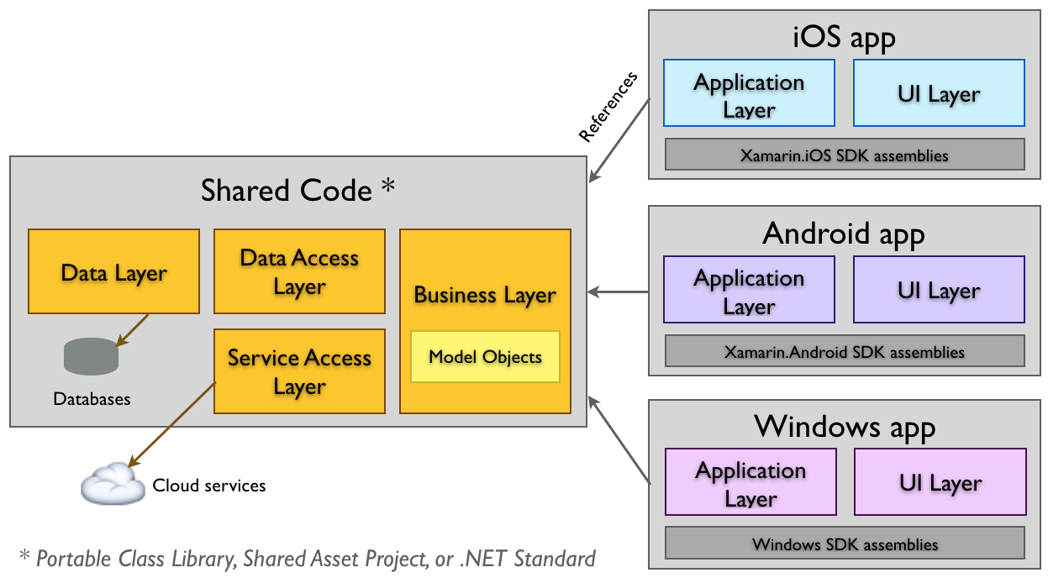
Portable Class Libraries

Slide 9
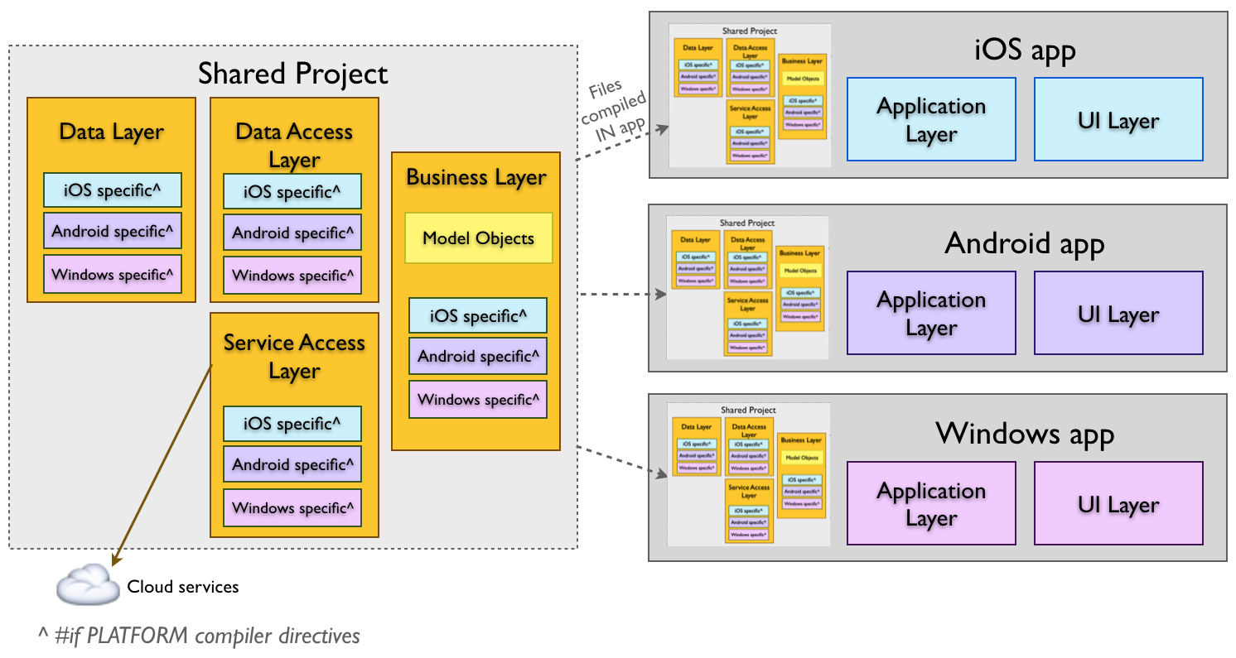
Shared Project

Slide 10
Thank You
Kishore Chowdary
C-Sharp Corner MVP
Developer Evangelist
CodeSizzler
@kishore_1702

